Slide 1
Exploring sex, sexual orientation and gender identity through interactive visualisations
Louise Capener, Nadia Kennar, J. Kasmire, Alle Bloom
UK Data Service, University of Manchester
Copyright © 2023 UK Data Service. Created by CSS Training Team, UK Data Service.
Notes:
Hi everyone, my name is Louise Capener and I’m a research associate at the UK Data Service. Today we’re going to be “Exploring sex, sexual orientation and gender identity through interactive visualisations”. I’m also joined remotely by my colleague Nadia Kennar, who will be co-presenting from Manchester. Not attending today are our other 2 contributors, J. Kasmire and Alle Bloom.

Slide 2
Presentation outline
Background.
Visualisations.
Scatterplots.
Maps.
Q&A session.
Notes:
First, some background on existing research around GI and SO.
Then, a look at the 3 visualisations.
Finally, there is time for a brief Q and A.
Also, there will be 3 QR codes during this presentation to link to the visualisations and our GH repo.
You may want to get your phones ready.

Slide 3
Previous research – Sexual orientation
Sexual identity data is commonly collected across surveys e.g National Survey of Sexual Attitudes and Lifestyles (Natsal), Understanding Society and Health Survey.
However, these lack detail at a lower geographical level and often have limited samples.
Office for National Statistics (ONS) have previously produced experimental statistics on sexual identity in the UK using the Annual Population Survey (2013-2015, 2020).
However, these statistics are considered ‘unofficial’ and were created to assess methods more than produce results.
Notes:
Prior to the 2021 UK census, relatively little research addressed the UK’s sexual orientation profile.
For example, sexual identity information was collected in Natsal, Understanding Society, and the Health Survey for England, but not at lower geographical levels, and often with limited samples.
The ONS has also produced experimental statistics on sexual identity using data from the Annual Population Survey. This data is provided at local authority level, but is considered to be “unofficial” as it was created primarily to assess methods.

Slide 4
Previous research – Gender
Gender identity data much less widely collected (ONS 2020):
Trial of questions in Crime Survey for England and Wales, Active Lives Children and Young People survey, Taking Part Survey.
More widely collected in admin data but still not extensive.
International research includes the Canadian Census 2021 and Census’ from Nepal (2011), India (2011) and Pakistan (2017) which all included a ‘third gender’ option.
Notes:
Looking at GI, there’s even less data available.
Some relevant questions have been trialed in various UK surveys, but the best estimates currently come from admin data such as higher education.
Internationally though, we do see questions on GI in various censuses including C, I, N, and P.

Slide 5
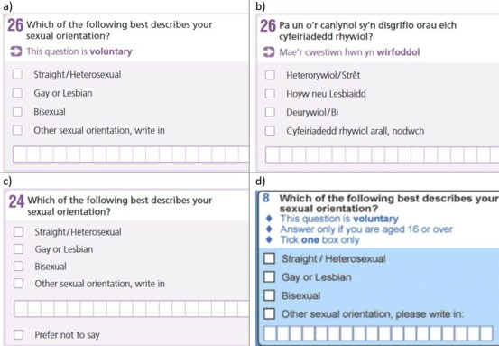
Census 2021
Which of the following best describes your sexual orientation?
Straight/heterosexual.
Gay or Lesbian.
Bisexual.
Other sexual orientation, write in.
Is the gender you identify with the same as your sex registered at birth?
“Yes” and “No, write in gender identity”
Questions were voluntary, varied slightly between England and Wales.
Allowed respondents to request an confidential individual form which overrode the information on a household form.
Notes:
So, to catch up with international research, the following questions were added to the 2021 census.
Both questions were voluntary, and the wording varied slightly between the different countries.
The census also allowed respondents to request an individual form that would be kept confidential from those in their household.

Slide 6
Why make interactive visualisations?
The 2021 census data provides the information at a level of geography that allows local authority areas to be visualised. This is a level of detail not available with other surveys.
The data therefore provides a unique opportunity to display this data at this detail.
Office for National Statistics (ONS) created maps to display the initial data, but these are single-variate.
The aim with our visualisations is to display the data in a way that allows users more control over what they can explore, allowing them to examine their own assumptions about their local area.
Notes:
Now to the main question: why make interactive visualisations of this new data?
The census data provides a novel opportunity to visualize these topics at a low-level geography and with a large sample size.
And whilst the ONS did create some interactive maps of these topics, their maps are only single variate.
So, we saw a great opportunity to build on this work. Low level geography, large sample size, and multivariate data make for complex data, so we wanted our visualisations to permit explorations that increase user understanding of this data.

Slide 7

What features influence non-response rates?
Hypothesis: GI question, unfamiliarity and wording → higher NR rate than SO
Scatterplots explored 2 variables:
Main language
Religion
Datasets: Gender identity and sexual orientation.
Area type: Lower tier Local Authorities.
Programming language: Python.
Integrated development environment (IDE): Jupyter Notebook.
Hosted on: GitHub.
Packages: Bokeh, pandas.
Platform for user interaction: Bokeh server.
Hosted on: Heroku.
Scan me!
Notes:
This is the first QR code which will take you to my interactive scatterplots and tables, which I will show you in a minute.
The interactive visualisations focus on NR rates. These questions are both novel and voluntary.
Further, the question on GI is probably less familiar and less clearly worded than the sexuality question. Respondents may not answer voluntary questions that they don’t understand.
I looked at main language and religion as factors, because main language and religion can be closely tied.
For instance, Islam is closely tied to the Arabic language, and Sikhism to Punjabi, and so on.
So I hypothesized that NR rates will be different between respondents whose main language isn’t English.
I further hypothesized that we’ll see different NR rates between the two questions (partly due to the wording of the GI question).
Just a brief note on my computational environment. I wrote my code in Python on Jupyter Notebook, and I deployed the visualisations to Heroku, a cloud-based platform.
But, please do get in touch if you want more details about the tools that I used.
Now, let’s have a look at the visualisations.

Slide 8
Interactive Mapping
Datasets: Gender Identity and Sexual Orientation.
Area Type: Local Authority.
Visualisation: Using two R packages to highlight the distribution of these categories in urban/rural areas, providing an interactive tool for exploratory analysis.
Programming language: R.
Integrated development environment (IDE): RStudio/Shiny App.
Hosted on: GitHub.
Packages: Leaflet, tmap, ggplot2, shiny
• Platform for user interaction: Shiny.
Hosted on: UoM Pilot Shiny Server.
Let’s dive in!
Notes:
Here, we have another QR code, if you scan it this will take you to my website with my interactive maps. We’re going to take a closer look at these after this slide.

Slide 9
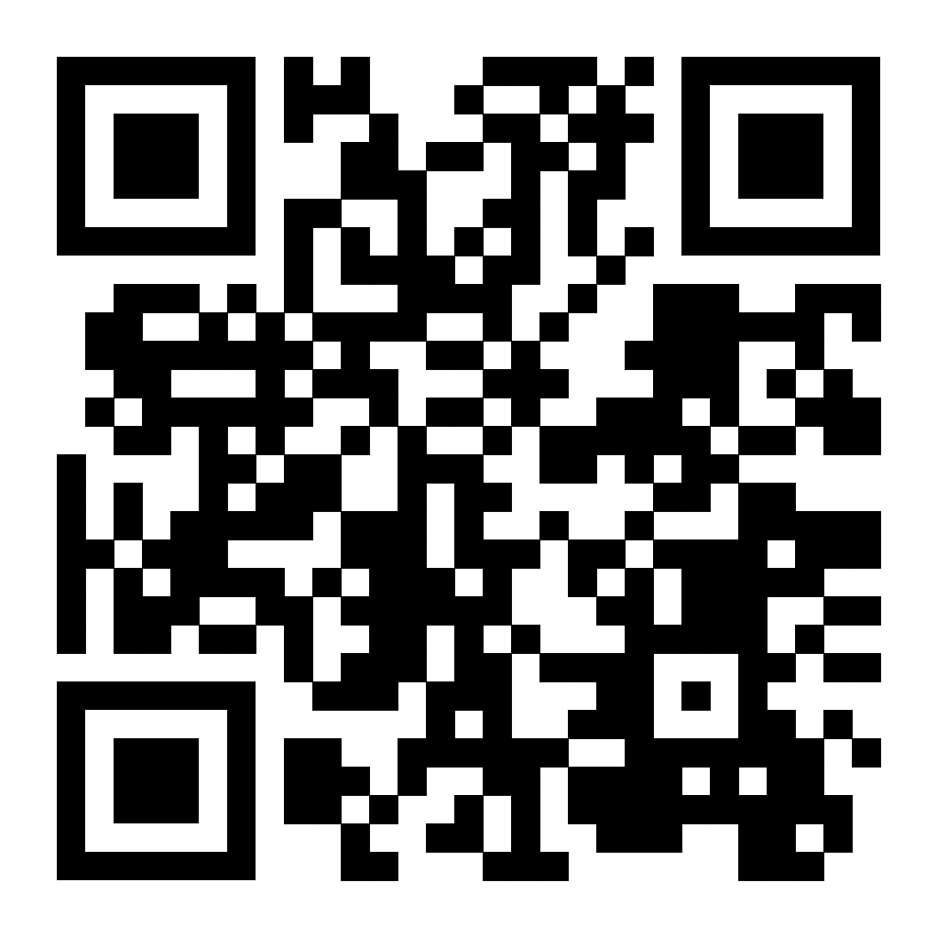
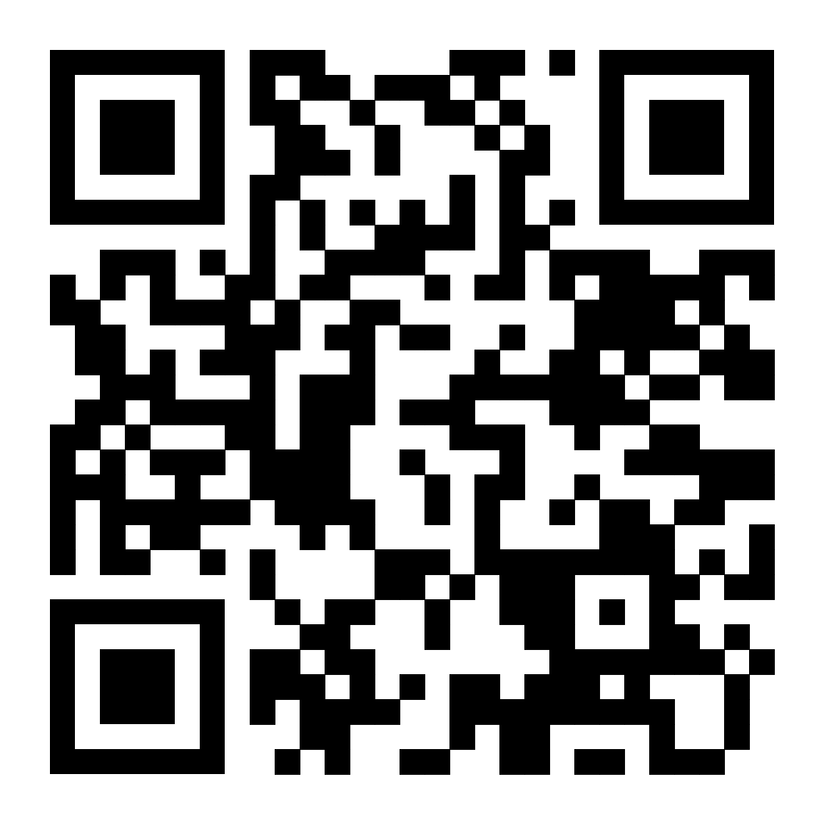
Gender Identity Maps
Sexual Orientation Maps
https://shiny.its.manchester.ac.uk/h08533nk/GenderIdentityMaps/
https://shiny.its.manchester.ac.uk/h08533nk/SexualOrientationMaps/

Slide 10
References
Oliver Duke-Williams. (2023). Census Explainer: sexual orientation and gender identity questions. [Online]. ukdataservice.ac.uk. Available at: https://ukdataservice.ac.uk/learning-hub/census/census-explainers/census-explainer-sexual-orientatio [Accessed 17 May 2023].
Sharfman, A, Cobb, P. (2022). Sexual orientation, UK: 2020. [Online]. Office National Statistics. Available at: https://www.ons.gov.uk/peoplepopulationandcommunity/culturalidentity/sexuality/bulletins/sexualident [Accessed 17 May 2023].
Knipe, E. (2017). Subnational sexual identity estimates, UK: 2013 to 2015. [Online]. Office for National Statistics. Available at: https://www.ons.gov.uk/peoplepopulationandcommunity/culturalidentity/sexuality/articles/subnationals [Accessed 17 May 2023].
Office for National Statistics. (2020). Exploring existing data on gender identity and sexual orientation. [Online]. https://www.ons.gov.uk/. Available at: https://www.ons.gov.uk/methodology/classificationsandstandards/measuringequality/genderidentity/exploringexistingdataongenderidentityandsexualorientation [Accessed 26 April 2023].
Office for National Statistics. (2023). Exploring existing data on gender identity and sexual orientation. [Online]. Office for National Statistics. Available at: https://www.ons.gov.uk/methodology/classificationsandstandards/measuringequality/genderidentity/expl [Accessed 17 May 2023].
Notes:
We have some references if anyone wants to check them out, but these slides will also be available online after the event, so you can always go back and take another look if needs be.

Slide 11



Thank you.
Louise Capener and Nadia Kennar
Email:
Louise.capener@manchester.ac.uk
Nadia.kennar@manchester.ac.uk
Want to check out our code?
GitHub:​​
UKDataServiceOpen/InteractiveGender
Twitter:​
@CapenerLouise​
@NadiaKennar
Notes:
Finally, thanks to everyone for attending, and if you want to check out our code the QR code here will take you to our GitHub repo for this project.
Also, mine and Nadia’s contact details and social media info are available if you want to get in touch with any questions or keep an eye on our future research projects.

